Slide 1
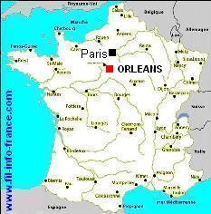
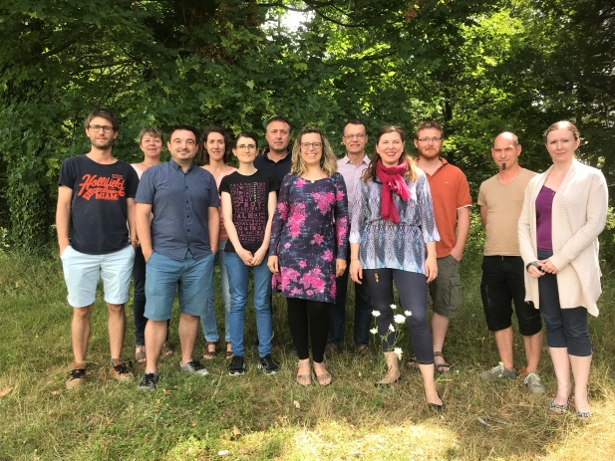
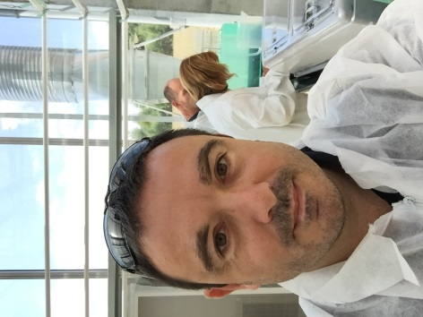
Prof. Stéphane MAURY
Laboratoire de Biologie des Ligneux et des Grandes Cultures
EA1207 University Orleans / USC1328 INRA (FRANCE)
http://www.univ-orleans.fr/lblgc/arche
Short description of your activities
Scientific and technical topics you work on :
Professor in Plant Physiology at University of Orleans (LBLGC) - INRA.
Associate-Director of LBLGC and Team leader of ARCHE.
Main topic: Tree tolerance to drought
Research in Plant Physiology
Expert in Epigenetics
Teaching for Masters
Plant eco-physiology
Phytomanagment
Epigenetics
Plant Genomics
https://www6.inra.fr/epitree-project/

